Slide 1
Hotel ABC – Hotel Management System Using Laravel
Kishan Arambhadiya (92300527142)
Bhavy Atkotiya (92300527183)
Uday Faliya (92300527083)

Slide 2
Project Overview
Objective:
Features:
Automate hotel operations
Reduce paperwork
Improve booking accuracy
Provide user-friendly interface
Room booking
Customer management
Payment tracking
Admin control panel

Slide 3
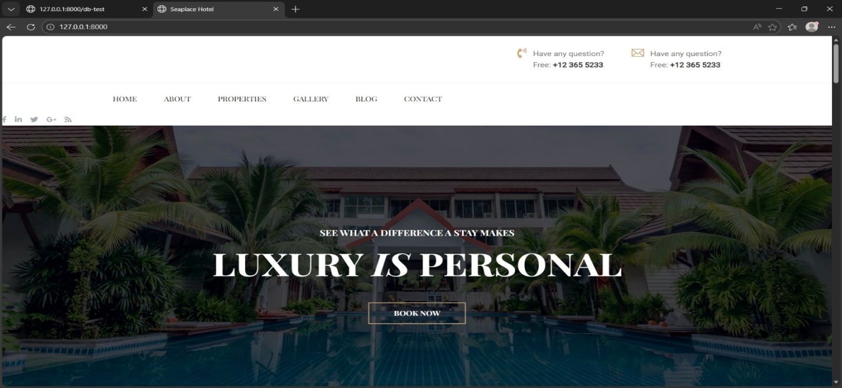
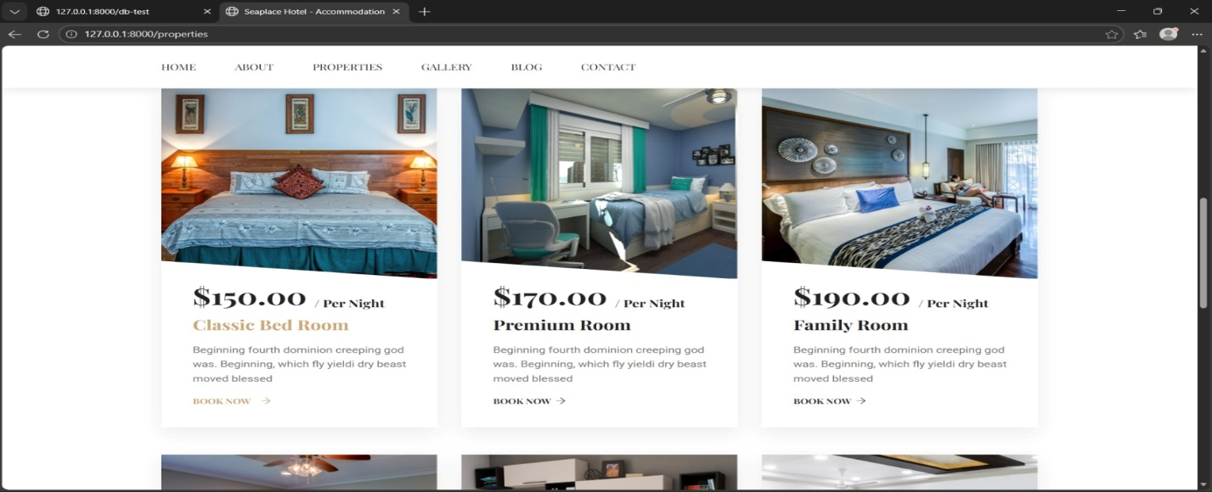
Main Dashboard (User Home Screen)
This is the homepage of the Hotel Management System developed using Laravel.
It provides easy navigation through menu options like Home, About, Properties, Gallery and Contact.
The banner section highlights hotel branding and attracts users.
The Book Now button allows customers to quickly start the room booking process.
This page improves user experience and accessibility.

Slide 4
Problem Statement & Need of System
Problems in Manual System:
Booking errors
Data redundancy
Time-consuming process
Poor record management
Need of Digital System:
Faster operations
Secure data storage
Easy report generation
Better customer experience

Slide 5
Technology Used
Backend:
PHP 8.x
Laravel 10 Framework
Frontend:
HTML
CSS
PHP
JavaScript
Tools:
VS code
XAMPP Server
Composer
Git
Database:
MySQL

Slide 6
Modules of System
Admit Module:
Manage rooms
View bookings
Manage users
Generate reports
User Module:
Registration & login
Search rooms
Book rooms
Generate reports
View booking history
Booking Module:
Real-time availability
Booking confirmation
Cancellation feature
Payment Module:
Payment processing
Invoice generation
Payment history

Slide 7
System Architecture
Model:
Handles database operations
View:
Displays user interface
Benefits:
Clean code structure
Easy maintenance
Better scalability
Controller:
Manages business logic

Slide 8
Database Design
Main Tables:
Users
Rooms
Bookings
Payments
Admin
Advantage:
Organized data
Faster retrieval
Data consistency
Relationship:
One user → Multiple bookings
One room → Many reservations
Each booking → One payment

Slide 9
System Screens & Interface
Main Screens:
UI Features:
Login Page
Registration Page
Dashboard
Room Listing Page
Booking Form
Payment Page
Admin Panel
Simple layout
Responsive design
Easy navigation

Slide 10
Learning Outcomes
Laravel MVC architecture
CRUD operations
Database relationships
Authentication & authorization
Backend & frontend integration
Debugging techniques
Team collaboration

Slide 11
Conclusion & Future Scope
Conclusion:
Future Enhancements:
Successfully developed hotel management system
Reduced manual work
Improved efficiency
Secure and scalable application
Online payment gateway
Mobile application integration
SMS & Email notifications
Advanced reporting dashboard

